Slide 1
Red Lion Hotel Corporation
Final Strategic Plan

Slide 2
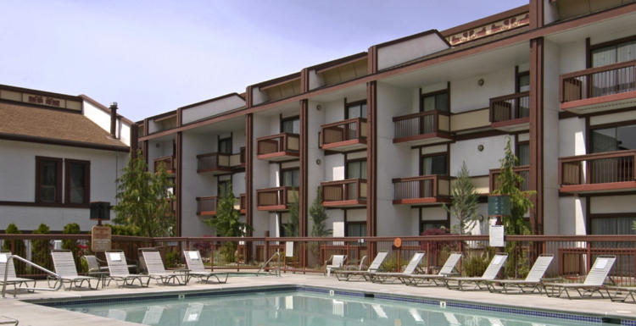
Executive Summary
Red Lion Hotel Corporation operations.
Internal and external environments.
Resource allocation.
Critical success factors.
Notes:
Red Lion Hotel Corporation needs that operates a number of hotels all over the world and provide a hotel products and services to its customers. The company offers value-add products such as swimming pools, gym facilities, and airport shuttles. The company has strength of collaboration among the hotel, entertainment, lodging, and franchising businesses. In spite of its strong internal environment, it is vulnerable to global diseases such as HINI and SARS. Besides, Red Lion Hotel Corporation has a stiff competitive environment that forces it to be strategically-positioned in the market. The company ensures effective resource allocation and effective work delegation among its departments. Appropriate functional tactics, milestones, deadlines, budgeting, and risk management come in handy as there is need for the company to increase the number of products it offers to have a competitive edge

Slide 3
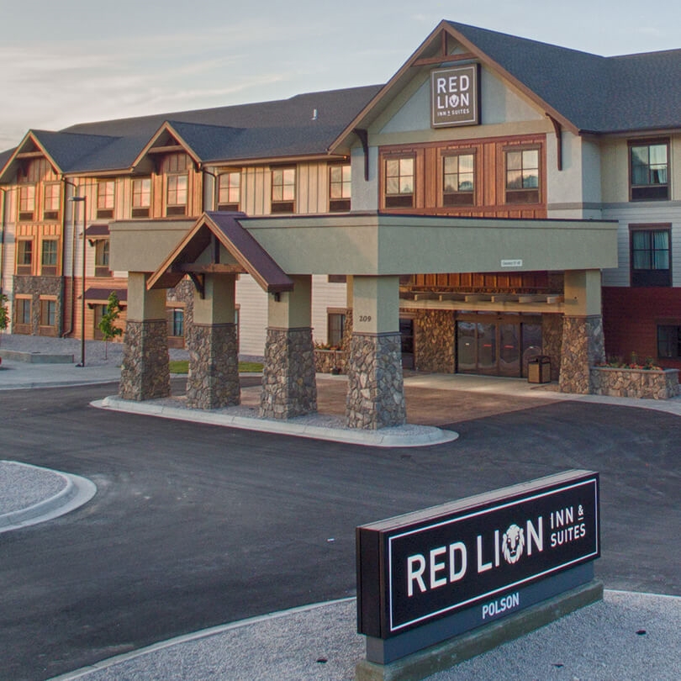
Red Lion Hotel Corporation’s objectives
Mission statement
Vision statement
Value statement
Notes:
Mission statement: Red Lion Hotel Corporation is company that is innovation-centered and focuses on management, franchising, and ownership of upscale.
Vision statement: The company looks forward to maximizing its capital investments for hoteliers across the North American region through viable brand managements and technological advancements.
Value statement: The company offers forward-thinking services that aim at enhance customer satisfaction by offering quality products and services.

Slide 4

Environmental Scan
Resource utilization.
Organizational harmony.
Globalization.
Competitive environment.
Notes:
Organizational objects are attainable if a company utilizes its available resources well. Also, the management should evaluate who the workers or departments coordinate in their operations. Besides, globalization marketing of the hotels and Franchise product has made the company vulnerable to global diseases like SARS and HINI (Shao, 2011). Lastly, It has competing companies like Marriott International Hotels, InterContinental Hotels, and Starwood Hotels.

Slide 5

Internal Environment
Properties and products.
Midscale position.
Good leadership.
Notes:
There are 32 hotels with a total of 6243 rooms and a space of about 309684 square feet for holding meetings (Shao, 2011). Red Lion Hotel Corporation occupies the midscale position in terms of food and beverage when compared to other hotels which rank in the full- service position. At the helm of a good internal environment are good leaders that propagate its organizational cultures over the years.

Slide 6

External Environment
Global diseases.
Stiff competition from rival companies.
Technological advantage.
Notes:
Although the hotels and Franchise products, encounters the issue of global diseases like SARS and HINI in some areas the organization still sales in disease free zones (Shao, 2011). From a competitive standpoint, the corporation has to contend with the fact that its core competitors have more properties and products. Besides, the competitors use advanced technologies and have more space and many customers than Red Lion Hotel Corporation.

Slide 7

Strategic Recommendation Implementation
Radical functional tactics.
Action items and take ownership.
Deadlines and milestones.
Notes:
The hotel will need to increase the size of its entertainment to prevent the tradeoffs of offering lower prices on the service. The strategic goals can only be achieved when the company deploy action items and take ownership activities that focus on employee training, proper pricing strategies, technological adoption, and good leadership. The importance of meeting deadlines and setting milestone are achievable through proper planning.

Slide 8

Cont.
Resource allocation.
Budgetary considerations.
Assignment delegation.
Notes:
The management needs to effectively distribute value-add packages, swimming pools, airport shuttles, and gym facilities throughout its 32 hotels worldwide. Good budgeting and assignment delegation strategies need to be implemented in the corporation by increasing profitability, managing supply chains, and distribute channels effectively.

Slide 9

Forecasted Financials
Statistical evidence from US Department of Labor.
Break-even point analysis.
Total revenue and total cost components.
Notes:
The US Department of Labor provided statistical evidence that showed that the lodging industry provides rooms at an approximate rate of $97.45 and the projected revenue per room is $53.71 (Shao, 2011). Even though Red Heart Hotel Corporation is a midscale organization, it is likely to reach the break-even point fast with the new strategic plan. Total revenue increases when the sales improve significantly. Fixed cost components are essential in the break-even analysis since are based on the unit variable costs of the products and services.

Slide 10

Organizational Change and Management Strategies
Provision of incentives.
Redefinition of cultural values.
Proper employee recruitment and training programs.
Notes:
The company needs to provide incentives to the employees to motivate and engage them in the new direction. Redefinition of cultural values is essential to ensure that the employees align the way the work with organizational expectations. Lastly, the corporation needs to recruit and retain employees that resonate with the expectations of transformative changes.

Slide 11

Risk Management Plan
Protective mechanisms.
Competitive counter-measures.
Collaboration and environmental protection.
Notes:
Protective mechanisms should be adopted to prevent the hotel from global diseases such as SARS and HINI in specific areas of the hotel’s operation. The corporation is operating in a highly-competitive market and the actions of every competitor adversely affect it. Besides, the management needs to establish collaborative efforts among all departments to enhance efficiency. Lastly, the corporation needs to promote environmental sustainability by adhering safety compliance when disposing waste products.

Slide 12
Reference
Shao, Y. C. (2011). Red Lion Hotel Corporation.

